Slide 1
Addressing Neurodiversity in the IFP at Middlesex University Mauritius
‘Their strengths and deficits do not deny them humanity but, rather, shape their humanity’
Roy Richard Grinker¹
1. Grinker (2010)
This Photo by Unknown Author is licensed under CC BY-SA-NC

Slide 2
Link to recorded presentation:
https://www.play.mdx.ac.uk/media/Rostom_G_Addressing+Neurodiversity+in+the+IFP+at+Middlesex+University+Mauritius/1_1l536hly
This Photo by Unknown Author is licensed under CC BY-SA-NC

Slide 3
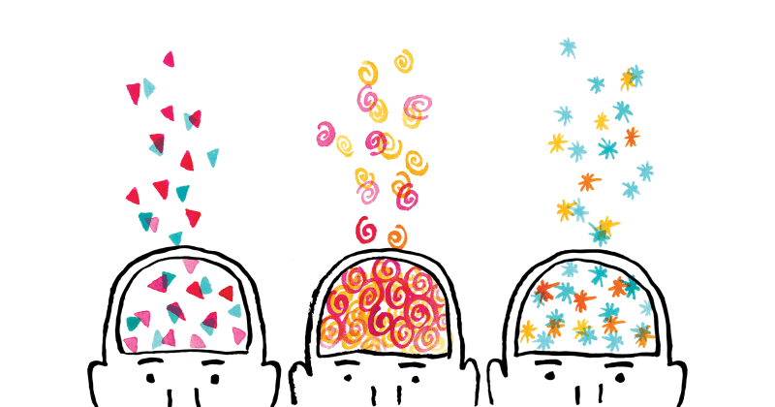
outline
What is Neurodiversity
Neurodiversity in Mauritius
Setting the Scene – the IFP at Middlesex University Mauritius
Standing on Shoulders of Giants: Compassionate Pedagogies and UDL
The Intervention
Evaluation
Limitations and way forward
This Photo by Unknown Author is licensed under CC BY
This Photo by Unknown Author is licensed under CC BY-SA
Neurodiversity at MUM

Slide 4
neurodiversity
Neurodiversity:
“(…) naturally occurring variation in the ways that humans perceive, experience and interact with the world, encompassing neurodevelopmental differences such as autism, attention deficit disorder (ADHD), dyslexia, developmental language disorder (DLD), dyscalculia, and developmental co-ordination disorder (DCD).”¹
Not (necessarily) a diagnosis^{2, 3}, but a broad or umbrella term.
This Photo by Unknown Author is licensed under CC BY-SA-NC
1. Hamilton & Petty (2023) | 2. Mirfin-Veitch et al. (2020) | 3. Singer et al. (2021)
Neurodiversity at MUM

Slide 5
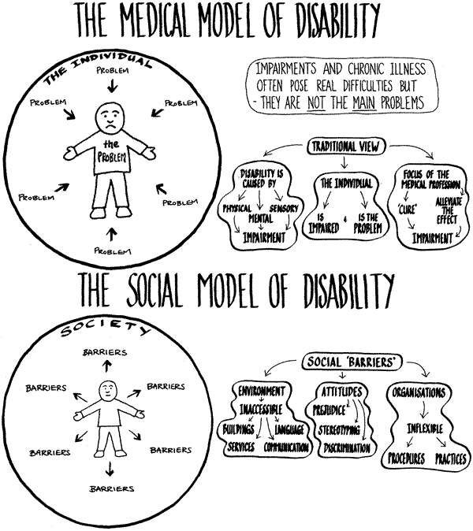
neurodiversity
A reframing of learning differences, neurodevelopmental disorders, and people with disabilities
1. Neurodivercity (n.d.)
Neurodiversity at MUM

Slide 6
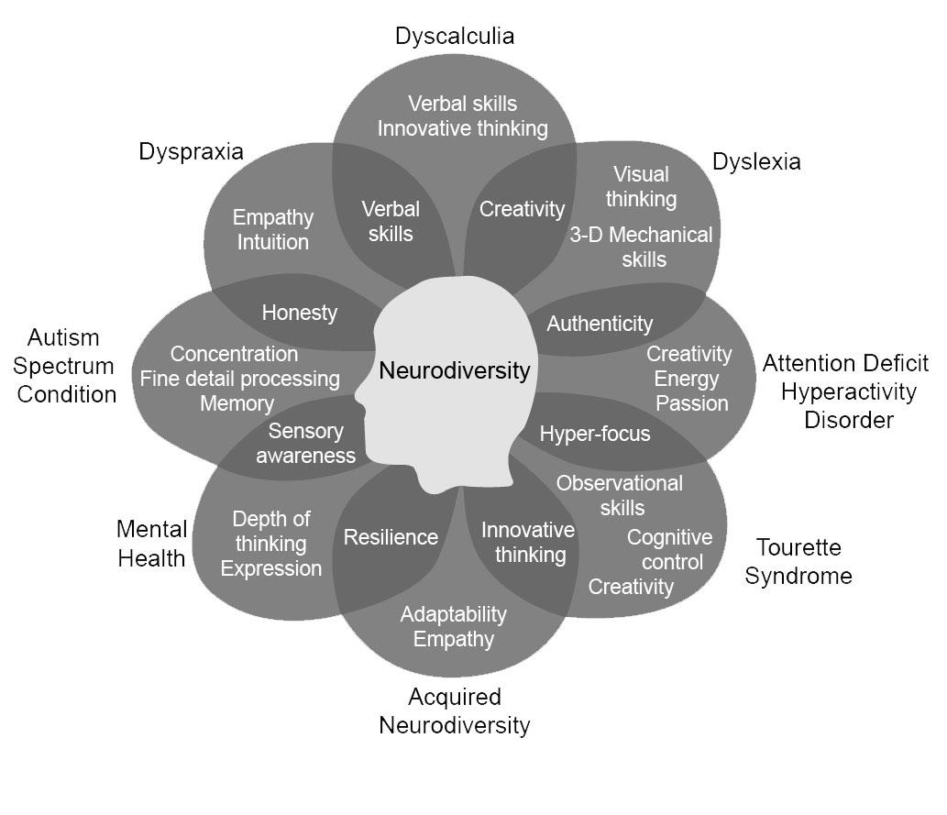
The Overlapping Skills and Strengths of Neurodiversity²
neurodiversity
A movement promoting “humility, compassion, respect and genuine impartiality.”¹
Growing literature and interest in Academia (both staff & students) and the workplace³
1. FFORT - Framework for Open and Reproducible Research Training (2023)
2. NCI Division of Cancer Epidemiology & Genetics Staff (2022) Credit: Created by Nancy Doyle, based on work by Mary Colley.
3. Austin & Pisano (2017); Clouder et al. (2020); Dugan (2023); Hamilton & Petty (2023); Mellifont (2023); Pellicano & Den Houting (2022)
Neurodiversity at MUM

Slide 7
neurodiversity
Neurodiversity in Higher Education is “a shared and growing challenge internationally”¹
An increasing number of neurodivergent students across the campus, globally.^{1, 2}
Anxiety follows them in “the personal, social and academic aspects of their studies.”³
Pre-existing learning difficulties exacerbate their “mental health and wellbeing concerns.”³
Due to “hidden curriculum,” past negative experiences at school, and overreliance on written forms of assessments.⁴
Affects sense of belonging, retention, academic achievement, and eventual employment.^{1, 2, 4, 5}
1. Clouder et al. (2020, p.1) | 2. Dungan (2023) | 3. Clouder et al. (2020, p.17) | 4. Hamilton and Petty (2023)
5. FFORT (2023); McIntosh (2020); Mirfin-Veitch et al. (2020); Pellicano & Den Houting (2022) ; Rosqvist et al., (2020)
Neurodiversity at MUM

Slide 8
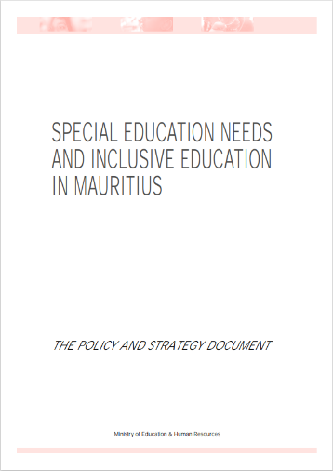
EDucation for persons with disabilities in mauritius
Mauritius – A Welfare State: Free Education for All
Prominence of the medical model of disability
Education of children with disabilities still segregated
Mostly run by Civil Society and Non-Govt. Organisations – Lack
“necessary support, monitoring and regulatory guidance”¹
Special Education Needs Authority Act of 2018 “cemented” Special
Education Needs (SEN) Schools as “a main pillar of the education
system”²
3
1. Mahadew & Mootooveeren (2020, p.1) | 2. Purmah (2021, p.177)
3. Ministry of Education and Human Resources (2006)
Neurodiversity at MUM

Slide 9
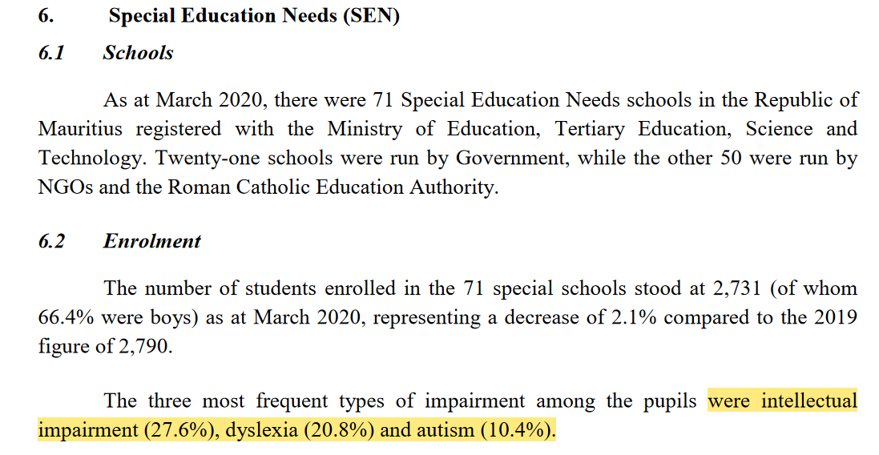
EDucation for persons with disabilities in mauritius
¹
1. Statistics Unit - Ministry of Education, Tertiary Education, Science and Technology (2020)
Neurodiversity at MUM

Slide 10
Neurodiversity in mauritius
1
“(…) it is estimated that only 1 percent of persons with disabilities (PwDs) enrolled at SEN schools progress on to university.”²
University students not aware of existing facilities and “were often neglected in terms of supporting structures and resources”.³
Neurodiversity as a concept or movement – Not yet part of the public or academic narrative
1. Statistics Unit - Ministry of Education, Tertiary Education, Science and Technology (2020)
2. Neves (2020) | 3. Pudaruth et al. (2017)
Neurodiversity at MUM

Slide 11
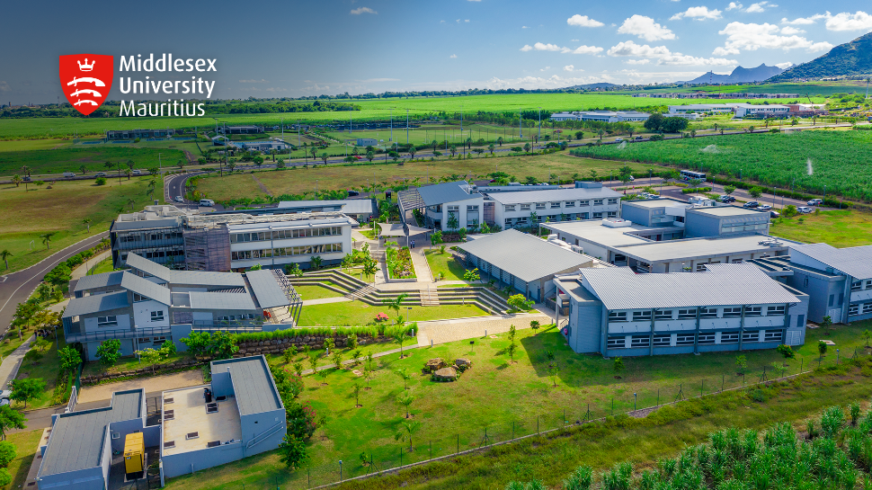
Setting the scene – Middlesex University mauritius
Founded in 2009
Current: 1600 Students and 110 staff members
Around 40% International Students, mainly from East and Sub-Saharan African countries
Neurodiversity at MUM

Slide 12
MUM IFP Enrolment (2013-2021) [n=750]
Germany (2)
France (1)
Italy (1)
Turkey (2)
Saudi
Arabia (2)
India
(1)
UAE (2)
Nepal
(1)
Nigeria
(115)
Somalia
(22)
Qatar (2)
Kenya
(36)
Uganda (34)
Sri Lanka
(1)
Ghana
(6)
Cameroon
(4)
DRC
(3)
Seychelles (4)
Rwanda (10)
Burundi (1)
Brazil
(1)
Tanzania (126)
Zambia (11)
Mozambique (3)
Botswana (5)
Namibia (1)
Madagascar
(22)
Mauritius (221)
Malawi (3)
Zimbabwe (42)
South Africa (5)
*Unspecified (82)
World map by www.freeworldmaps.net

Slide 13
Middlesex University mauritius – Disability Support Policy
Disability Support Services – centralised under Academic Registry Department
Academic Support and Reasonable Adjustments through (confidential) disclosure and Learning Support Forms submissions
Neurodiversity Week since 2023
This Photo by Unknown Author is licensed under CC BY
This Photo by Unknown Author is licensed under CC BY-SA
Neurodiversity at MUM

Slide 14
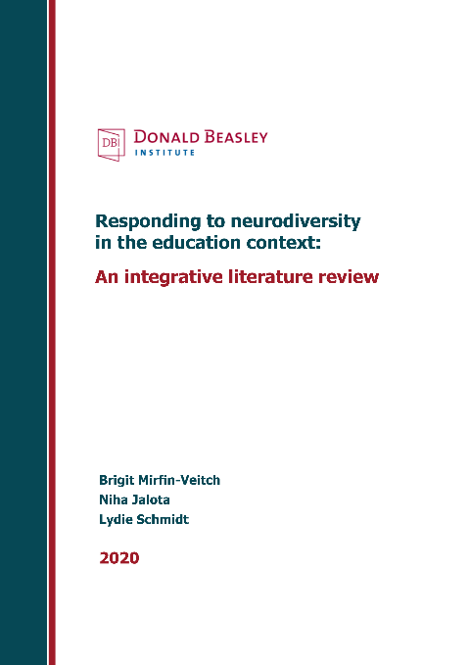
Theoretical foundation
Inclusion as the overarching principle¹
Prioritising and valuing relationships
Developing agency
Supporting students to understand and manage their own behaviour
Creating inclusive environments
Embedding inclusive teaching strategies
1. Mirfin-Veitch et al. (2020)
Neurodiversity at MUM

Slide 15
Theoretical foundation
Compassionate pedagogies and strengths-based approaches
Pay special attention to distress and take measures to alleviate them, through active listening, curiosity and empathy
Foster a sense of belonging and purpose in the learning community
Notice, point out and harness strengths of neurodiverse students to increase engagement and learning
Universal Design for Learning
1. Mirfin-Veitch et al. (2020)
Neurodiversity at MUM

Slide 16
Universal Design for Learning
A (holisitic) framework and a strategy that offers suggestions and design principles for teaching and learning
Not a deficit model, and not prescriptive.
Reduce barriers and maximise learning opportunities
The “Heart of UDL”: “Embedding Inclusion and Choice”¹
1. McIntosh (2020)
Neurodiversity at MUM

Slide 17
Universal Design for Learning
UDL 3 Principles visual representation¹
1. Middlesex University: My Learning Essentials (n.d.)
Neurodiversity at MUM

Slide 18
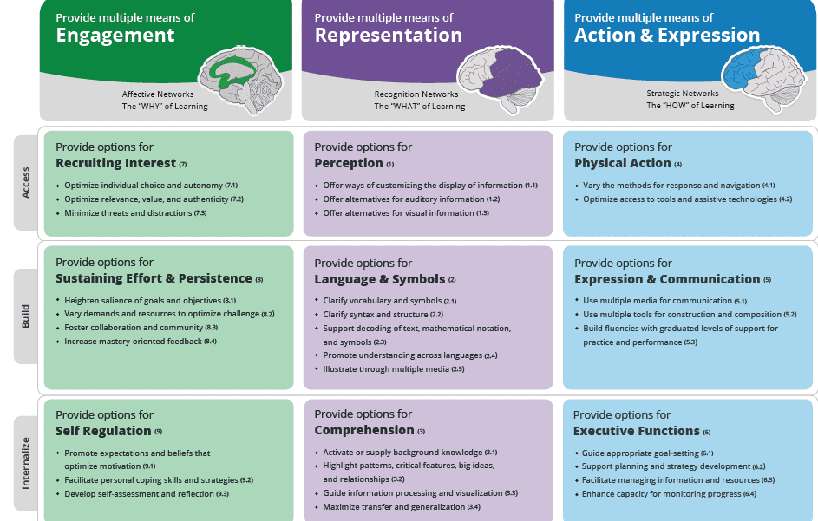
Universal Design for Learning
UDL Guidelines¹
1. Middlesex University: My Learning Essentials (n.d.)
Neurodiversity at MUM

Slide 19
The Intervention (1)
Objectives:
To raise awareness about, and normalise conversations around, disability and neurodivergence among IFP students
To increase the number of IFP Students submitting Learning Support Forms and receiving individualised support
To make learning materials more universally accessible
Neurodiversity at MUM

Slide 20
The Intervention (2)
Programme Level:
Information session on Neurodiversity during Induction Week
More detailed session by Academic Registry about DSS
Training to teachers in the programme, including the academic tutor
Neurodiversity at MUM

Slide 21
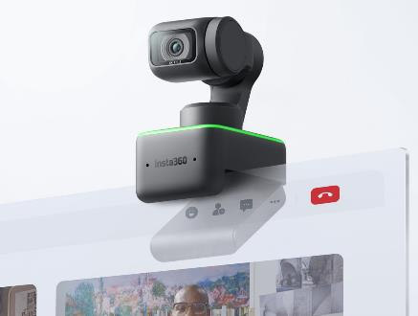
The Intervention (3)
Module Level:
Enhanced Lecture-Capture through Zoom, MDXPlay and Insta360 Link Webcam
Writing Assignment Planner (WrAP)²
Checklists for assignments
Insta360 Link - Gesture Control¹
²
Insta360 Link Webcam¹
1. Insta360 (n.d.) | 2. Baron Levi (2020, p.81)
Neurodiversity at MUM

Slide 22
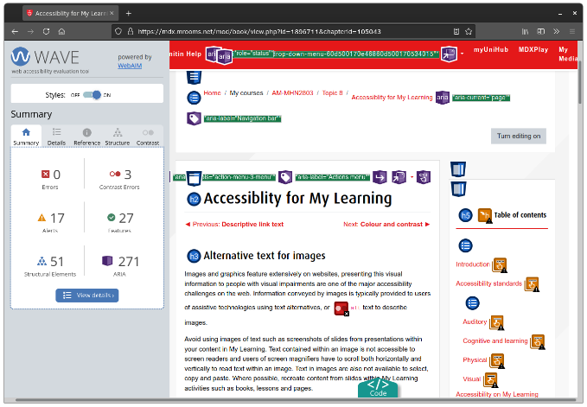
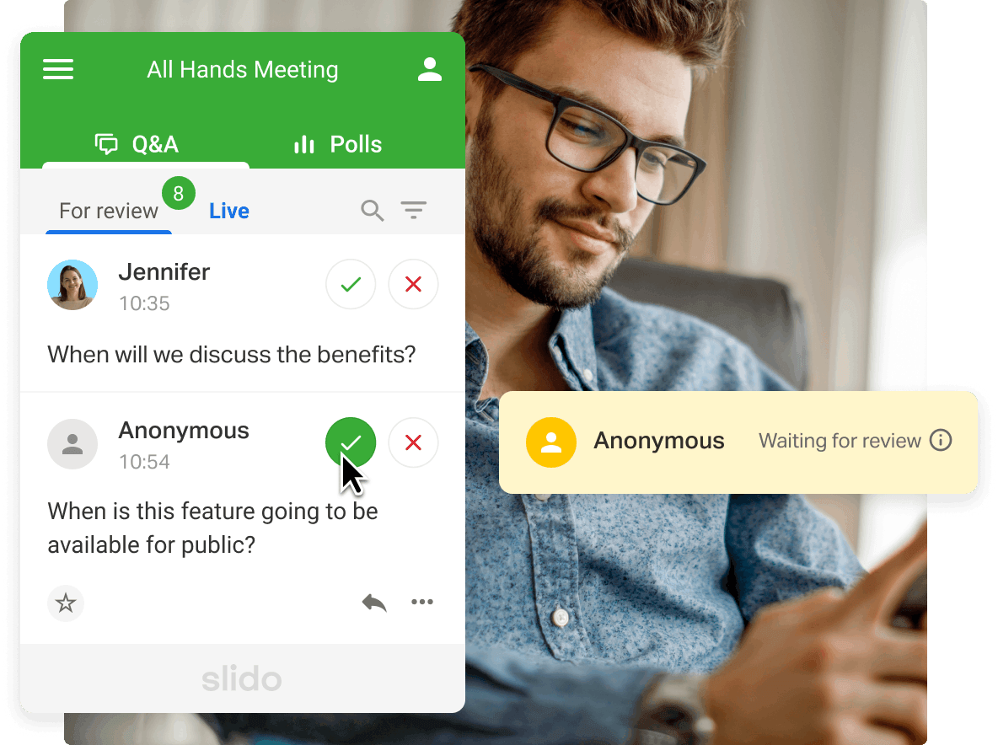
The Intervention (4)
Module Level:
Review and revamp^{1, 2} of module pages, starting with LAW0701
WAVE web accessibility evaluation tool
The Book feature on Moodle (MyLearning)
Slido for anonymous Q&A
Screenshot of WAVE tool in use on a My Learning page²
Slido - Live Q&A Moderation³
1. Edwards (2023) | 2. Middlesex University: My Learning Essentials (2021) | 3. Slido (n.d.)
Neurodiversity at MUM

Slide 23
Evaluation
Programme Level:
Pre- and post-test after info sessions: Slido or Zoom Survey Feature
Establish baseline : # of LSF submitted over the years & # of students receiving support
# of Neurodiversity training sessions and # of staff participants
1. Insta360 (n.d.)
Neurodiversity at MUM

Slide 24
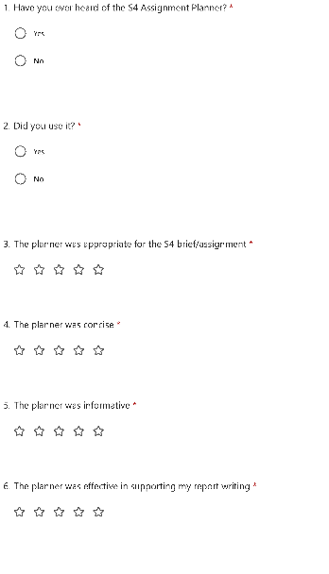
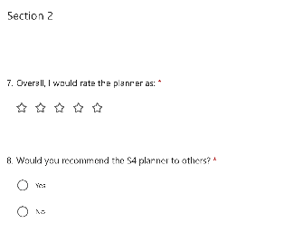
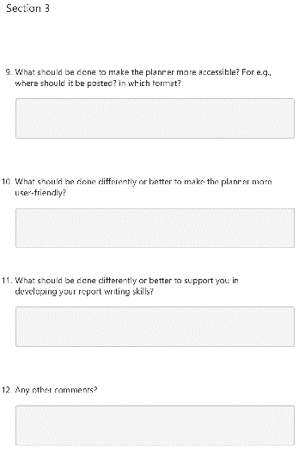
Evaluation
Module Level:
Evaluation form for Insta360 link, WrAP, Checklists and Slido
Revamping Module Page:
Mixed quali method: Co-Design¹
& Photo Elicitation² Pre- and Post-changes + WAVE
1. Tremblay et al. (2022) | 2. Glaw et al. (2017)
Neurodiversity at MUM

Slide 25
Limitations
Lack of preliminary data on the prevalence of people who identify as neurodiverse
The issue of diagnosis?
Limited specialised resources, programmes or initiatives due to the relative size of the Institution.
Measuring compassion?
Neurodiversity at MUM

Slide 26
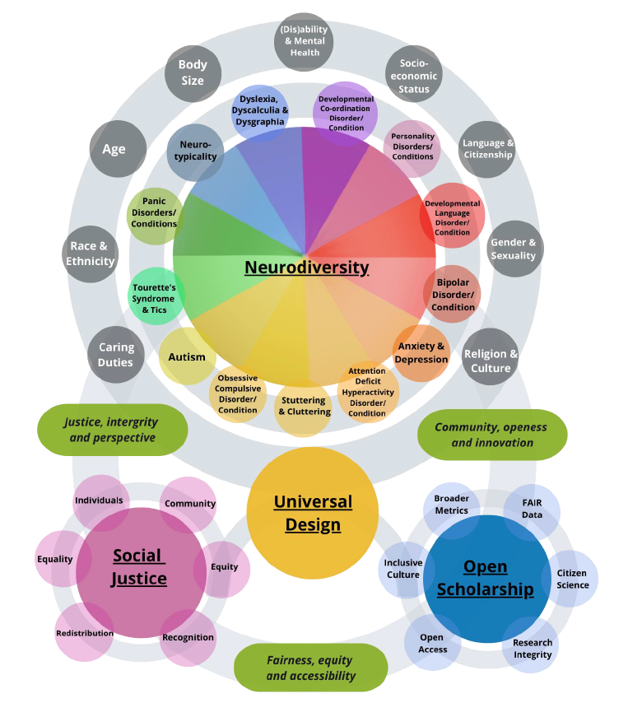
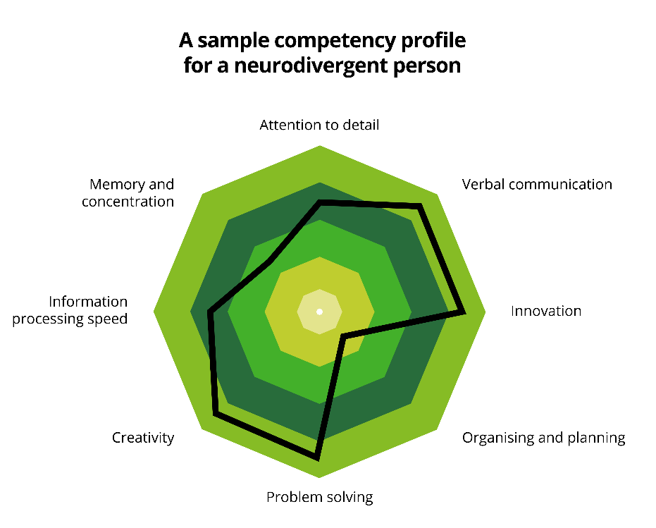
The nested intersecting spheres of neurodiversity²
The way forward
¹
1. Deloitte (2022) | 2. Elsherif et al. (2022)
Neurodiversity at MUM

Slide 27
Thank you for your attention!
Neurodiversity at MUM

Slide 28
References (1)
Austin, R. D., & Pisano, G. P. (2017, May 1). Neurodiversity as a Competitive Advantage. Harvard Business Review. https://hbr.org/2017/05/neurodiversity-as-a-competitive-advantage
Baron Levi, J. (2020). The hairy bikie and other metacognitive strategies: Implementing a frontal lobe prosthesis for those whose learning is compromised. Springer.
Clouder, L., Karakus, M., Cinotti, A., Ferreyra, M. V., Fierros, G. A., & Rojo, P. (2020). Neurodiversity in higher education: A narrative synthesis. Higher Education, 80(4), 757–778. https://doi.org/10.1007/s10734-020-00513-6
Dugan, D. (2023). Neurodiversity in Higher Education [University at Buffalo, The State University of New York]. https://www.proquest.com/openview/ae16b7436699cf9ab6e802528994788f/1?pq-origsite=gscholar&cbl=18750&diss=y
Edwards, E. (2023, September 19). Developing an Accessible and Inclusive Learning Environment [Seminar]. Celebrating Teaching Excellence seminar, Middlesex University, Hendon and Online. https://www.play.mdx.ac.uk/media/Emilie+Edwards+Presentation+Final/1_05834wj3
Elsherif, M. M., Middleton, S. L., Phan, J. M., Azevedo, F., Iley, B. J., Grose-Hodge, M., Tyler, S. L., Kapp, S. K., Gourdon-Kanhukamwe, A., Grafton-Clarke, D., Yeung, S. K., Shaw, J. J., Hartmann, H., & Dokovova, M. (2022a). Bridging Neurodiversity and Open Scholarship: How Shared Values Can Guide Best Practices for Research Integrity, Social Justice, and Principled Education [Preprint]. MetaArXiv. https://doi.org/10.31222/osf.io/k7a9p
Elsherif, M. M., Middleton, S. L., Phan, J. M., Azevedo, F., Iley, B. J., Grose-Hodge, M., Tyler, S. L., Kapp, S. K., Gourdon-Kanhukamwe, A., Grafton-Clarke, D., Yeung, S. K., Shaw, J. J., Hartmann, H., & Dokovova, M. (2022b). The nested intersecting spheres of neurodiversity. https://doi.org/10.31222/osf.io/k7a9p
FFORT - Framework for Open and Reproducible Research Training. (2023). Team Neurodiversity: Integrating neurodiversity and open scholarship. FFORT - Framework for Open and Reproducible Research Training. https://forrt.org/neurodiversity/
Glaw, X., Inder, K., Kable, A., & Hazelton, M. (2017). Visual Methodologies in Qualitative Research: Autophotography and Photo Elicitation Applied to Mental Health Research. International Journal of Qualitative Methods, 16(1), 1609406917748215. https://doi.org/10.1177/1609406917748215
Grinker, R. R. (2010). Commentary: On Being Autistic, and Social. Ethos, 38(1), 172–178. https://doi.org/10.1111/j.1548-1352.2010.01087.x
Hamilton, L. G., & Petty, S. (2023). Compassionate pedagogy for neurodiversity in higher education: A conceptual analysis. Frontiers in Psychology, 14, 1093290. https://doi.org/10.3389/fpsyg.2023.1093290
Insta360. (n.d.). Insta360 Link—The AI-powered 4K webcam. Retrieved December 20, 2023, from https://www.insta360.com/product/insta360-link
Mahadew, A. R., & Mootooveeren, K. (2020). The Right to Education of Children with Disabilities in Mauritius: An Assessment of the Status of Education. International Journal of Law, Humanities & Social Science, 4(3), 56–78.
McIntosh, E. (2020, March). SAT Universal Design for Learning Methodology—A blueprint for all. Centre for Academic Practice Enhancement (CAPE), Middlesex University, Hendon and Online. https://www.play.mdx.ac.uk/media/SAT+Universal+Design+for+Learning+Methodology+-+A+blueprint+for+all.+/1_el20x9zw
Mellifont, D. (2023). Ableist ivory towers: A narrative review informing about the lived experiences of neurodivergent staff in contemporary higher education. Disability & Society, 38(5), 865–886. https://doi.org/10.1080/09687599.2021.1965547
Neurodiversity at MUM

Slide 29
References (2)
Middlesex University: My Learning Essentials. (n.d.). Universal Design for Learning (UDL) Staff Course. Retrieved December 5, 2023, from https://mdx.mrooms.net/mod/scorm/view.php?id=2073011
Middlesex University: My Learning Essentials. (2021). Creating accessible content on My Learning Part 1: Testing for accessibility. https://mdx.mrooms.net/mod/book/view.php?id=1953160&chapterid=107829
Ministry of Education and Human Resources. (2006). Special Education Needs and Inclusive education in Mauritius: The Policy and Strategy document. https://education.govmu.org/Documents/educationsector/Documents/Special%20Education%20Needs/sen.pdf
Mirfin-Veitch, B., Jalota, N., & Schmidt, L. (2020). Responding to neurodiversity in the education context: An integrative literature review. Dunedin: Donald Beasley Institute.
National Cancer Institute Division of Cancer Epidemiology & Genetics Staff. (2022, April 25). Neurodiversity. National Cancer Institute. https://dceg.cancer.gov/about/diversity-inclusion/inclusivity-minute/2022/neurodiversity
Neurodivercity. (n.d.). Medical & Social Models of Disability. NeuroDiverCity. Retrieved December 20, 2023, from https://www.neurodivercitysg.com/medical-model-vs-social-model.html
Neves, C. (2020, January 10). Global Rainbow Foundation | D&A | Diversity and Ability. Https://Diversityandability.Com/. https://diversityandability.com/?casestudy=global-rainbow-foundation
Pellicano, E., & Den Houting, J. (2022). Annual Research Review: Shifting from ‘normal science’ to neurodiversity in autism science. Journal of Child Psychology and Psychiatry, 63(4), 381–396. https://doi.org/10.1111/jcpp.13534
Pudaruth, S., Gunputh, R. P., & Singh, U. G. (2017). Forgotten, excluded or included? Students with disabilities: A case study at the University of Mauritius. African Journal of Disability, 6. https://doi.org/10.4102/ajod.v6i0.359
Purmah, N. R. (2021). Inclusive Education For Learners With Disabilities In Mauritius: The ‘Rights’ Way Forward. African Disability Rights Yearbook, 9, 160–186. https://doi.org/10.29053/2413-7138/2021/v9a8
Rosqvist, H. B., Chown, N., & Stenning, A. (Eds.). (2020). Neurodiversity Studies: A New Critical Paradigm (1st ed.). Routledge. https://doi.org/10.4324/9780429322297
Singer, J., Waisman, T., Grossman, E., Kofner, B., Shevchuk-Hill, S., Santos, J. D., & Kristen Gillespie-Lynch. (2021, March 4). Is Universal Design Enough? Learning from the Neurodiversity Movement How to Engage Diverse Learners [Workshop]. College of Staten Island Psychology Department Virtual Office. https://csipsy.commons.gc.cuny.edu/is-universal-design-enough-learning-from-the-neurodiversity-movement-how-to-engage-diverse-learners/
Slido. (n.d.). Slido—Live Q&A Moderation. Retrieved December 20, 2023, from https://www.slido.com/static/slido-live-q_a-moderation.d9548475.1600.png
Statistics Unit - Ministry of Education, Tertiary Education, Science and Technology. (2020). Education Statistics 2020. Statistics Unit - Ministry of Education, Tertiary Education, Science and Technology. https://statsmauritius.govmu.org/Documents/Statistics/ESI/2020/EI1543/Edu_Yr20.pdf
Tremblay, M., Hamel, C., Viau-Guay, A., & Giroux, D. (2022). User Experience of the Co-design Research Approach in eHealth: Activity Analysis With the Course-of-Action Framework. JMIR Human Factors, 9(3), e35577. https://doi.org/10.2196/35577
Neurodiversity at MUM

